Slide 1

Monday 22nd June 2026
Reading VIPERS
The goal for this week:
Read chapters of the book and use VIPER skills to show full understanding of the text.
Perform poetry with expression
Write about yourself in verse.

Slide 2
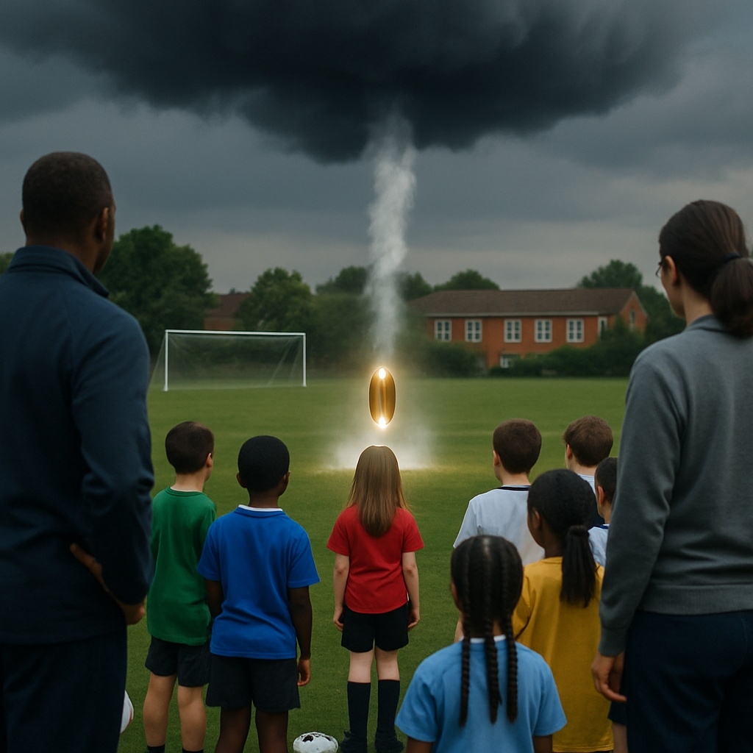

Slide 3
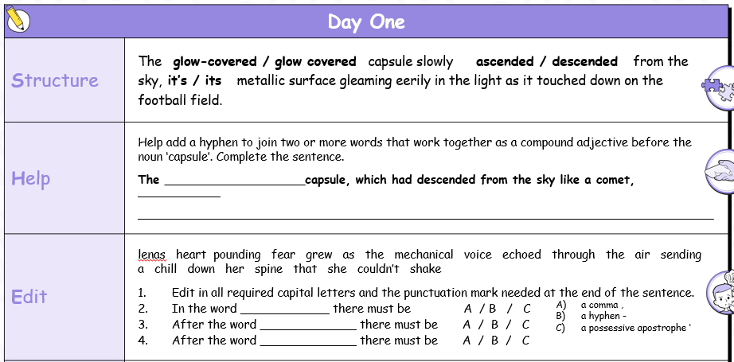

Slide 4
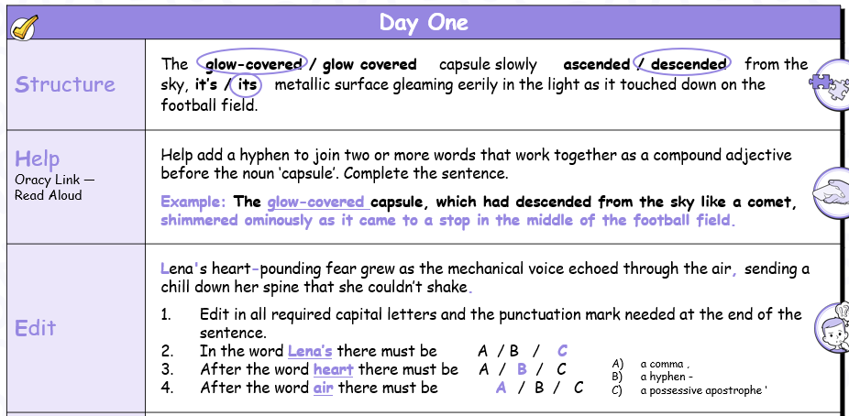

Slide 5
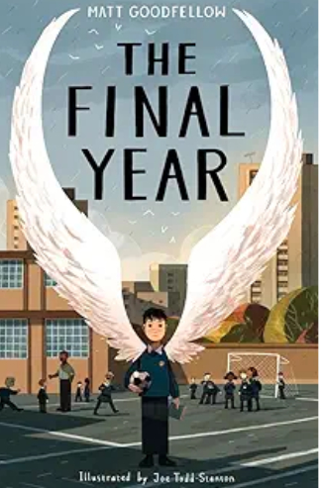
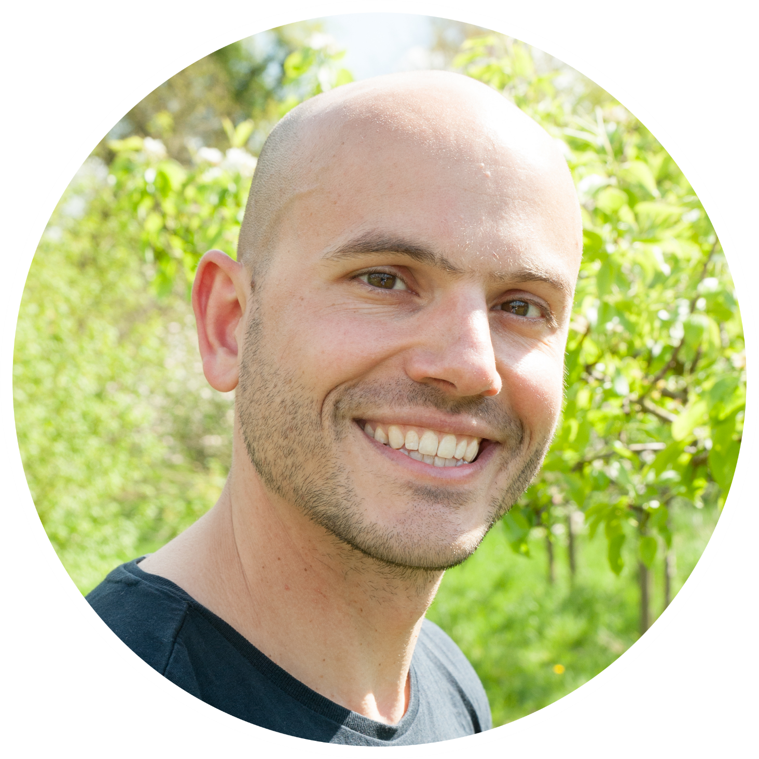
Notes:
Ask the children to look at the front cover. What do you think the book will be about? What things can you see on the front cover? Who do you think would enjoy this story and why? Where do you think this story is set? Why? Now read the blurb – were any of your predictions correct? The following questions are designed as prompts only – allow the children to come up with their own questions and ideas. They will be much more engaged this way
Life can be tough in your last year of primary school. Tests to take, preparing for the change to high school. Nate is ready for it all, knowing his best friend PS is at his side - they’ve been inseparable since Nursery.
But when they are put in two different classes and PS finds a new friend in Turner, the school bully, Nate's world turns upside-down. As he struggles to make sense of this and forge new friendships, he’s dealt another blow when his youngest brother, Dylan is rushed into hospital.
His new teacher, Mr Joshua, sees a spark inside of Nate that’s lit by his love of reading and writing and shows him how to use this to process what’s going on. But with so much working against him, and anger rising inside him, will this be enough?

Slide 6
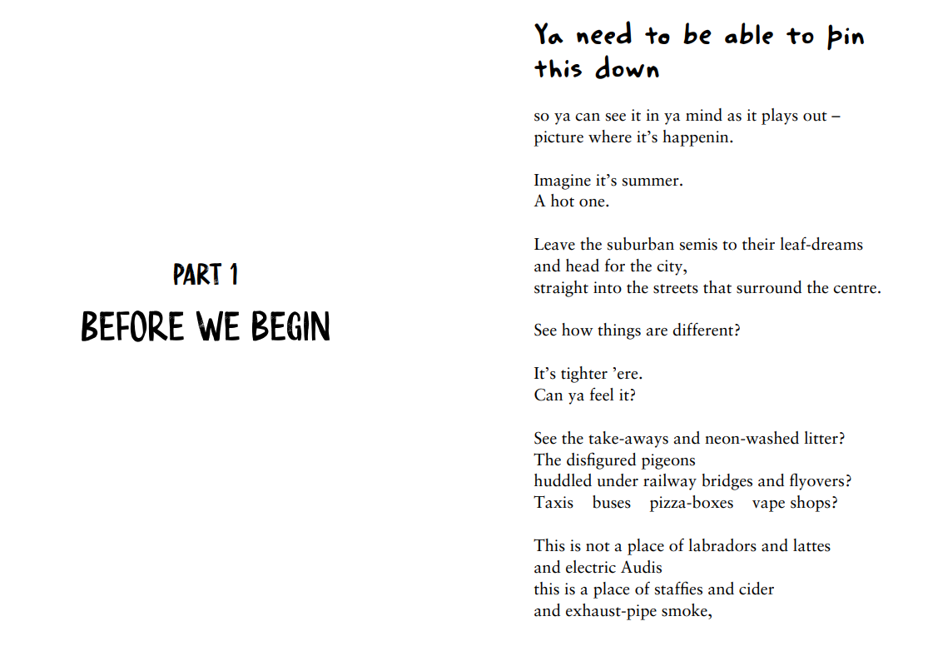

Slide 7
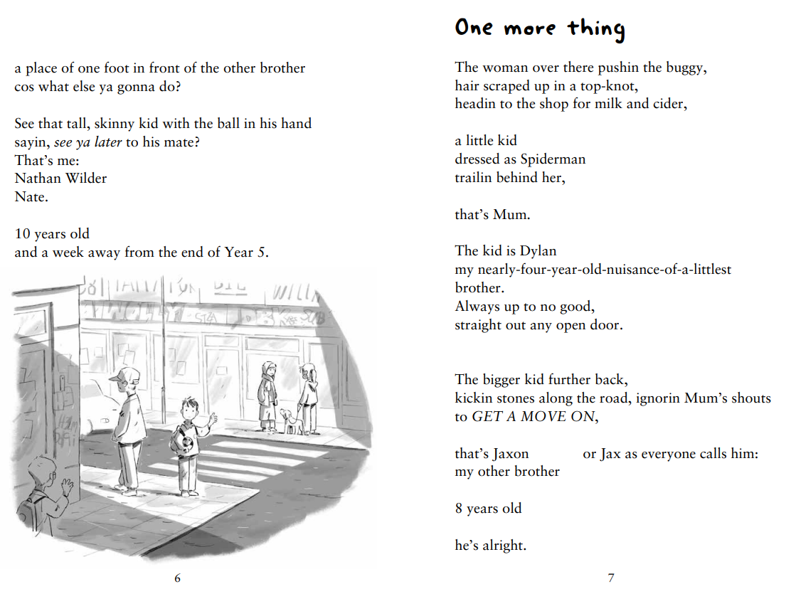

Slide 8
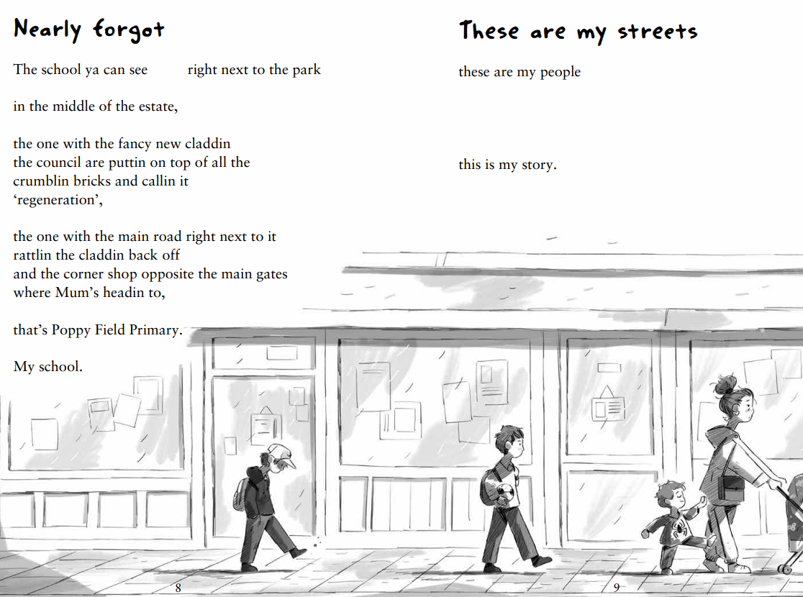

Slide 9
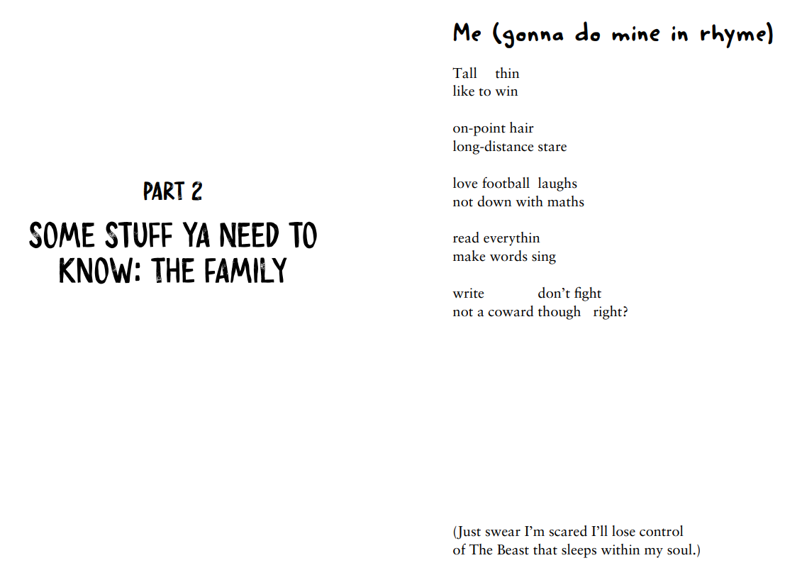

Slide 10
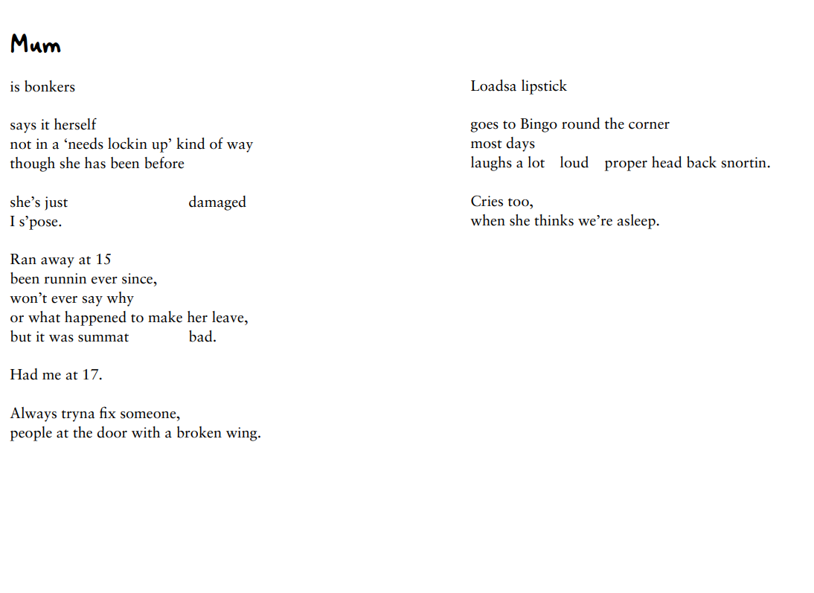

Slide 11
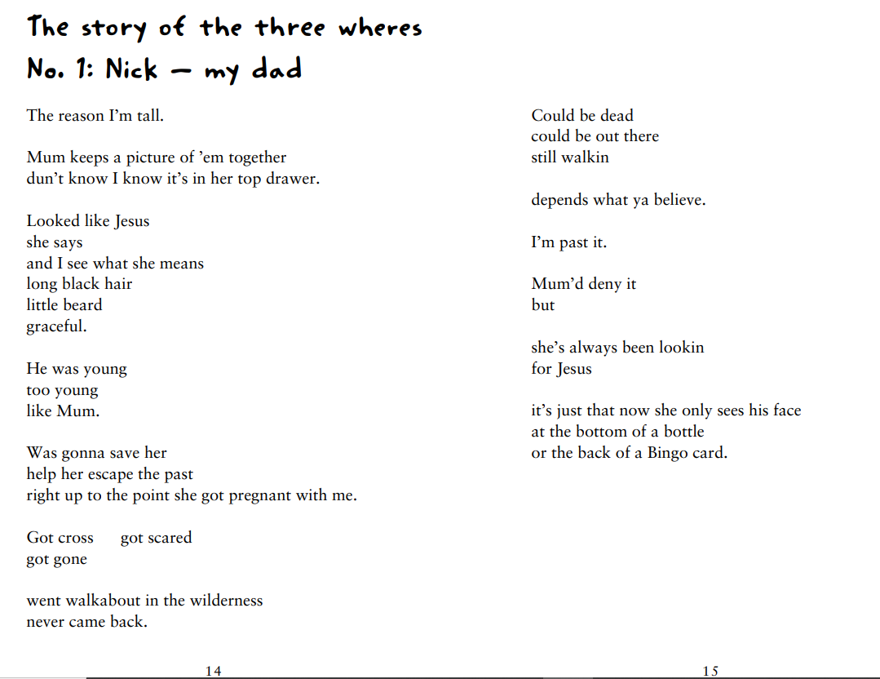

Slide 12
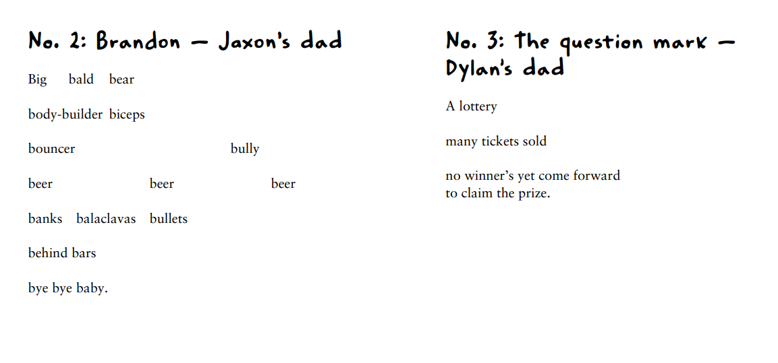

Slide 13
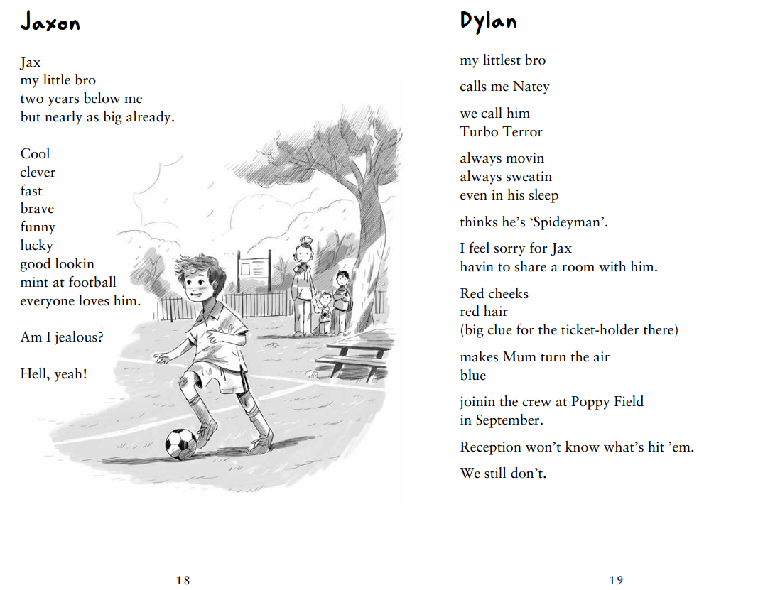

Slide 14
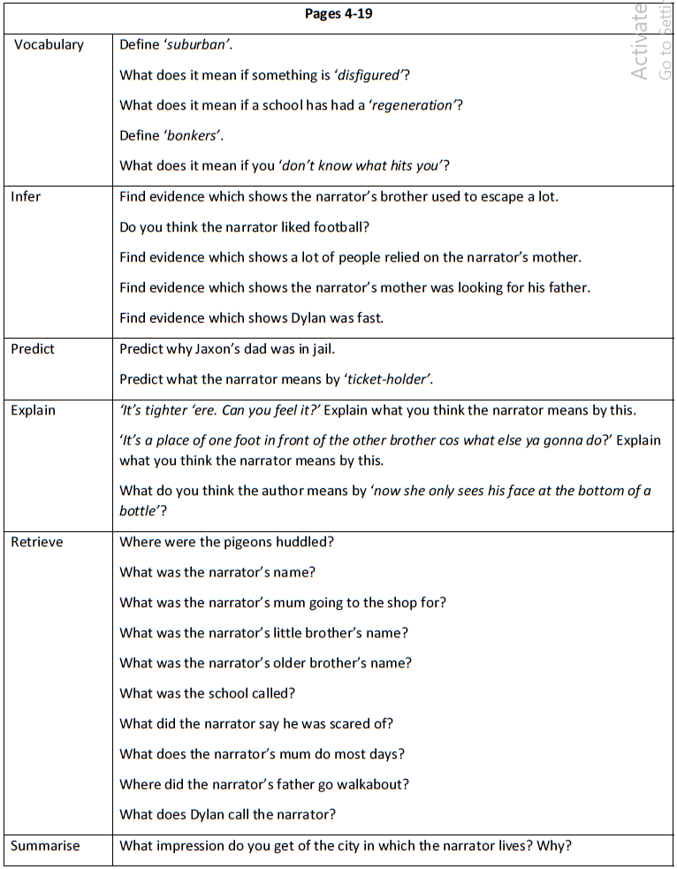

Slide 15
Scaffolds
Adult support
Paired working
Task
Complete VIPERS activity, choosing one from each section and then returning to the start.
Challenge
As task, and then …
How does Matt Goodfellow present Nate’s emotional state in these early pages, and what does this suggest about the challenges he is facing as he begins Year 6?
Support your answer with evidence from the text and explain the effect on the reader.

Slide 16
Plenary
Quick Fire Feelings Check
What does Nate feel at the start of Year 6?
Find one piece of evidence from the text to support your idea.

Slide 17
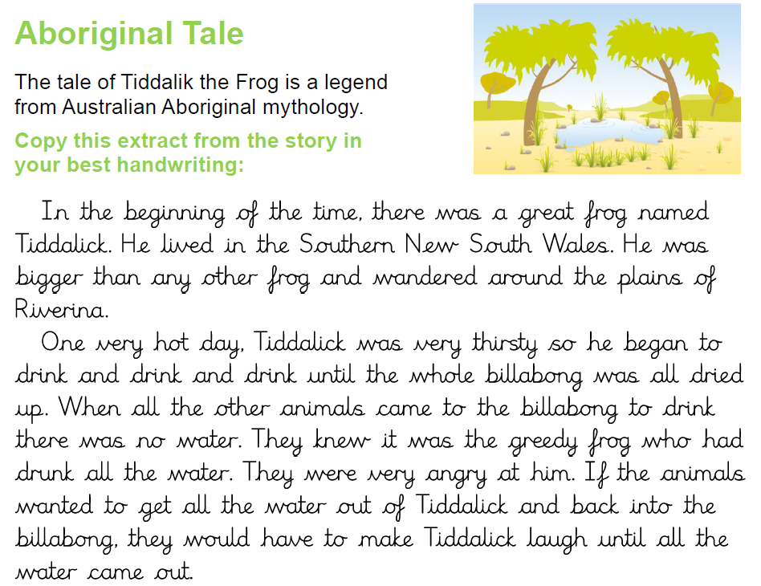
Tuesday 23rd June 2026
Rewrite the fable in your book. Take your time to allow for best handwriting.

Slide 18
Tuesday 23rd June 2026
Reading VIPERS
Our goal for today:
Use a range of reading skills to develop a deep understanding of the next section of the text.
Notes:
Arthur Spiderwick's Field Guide | PDF

Slide 19
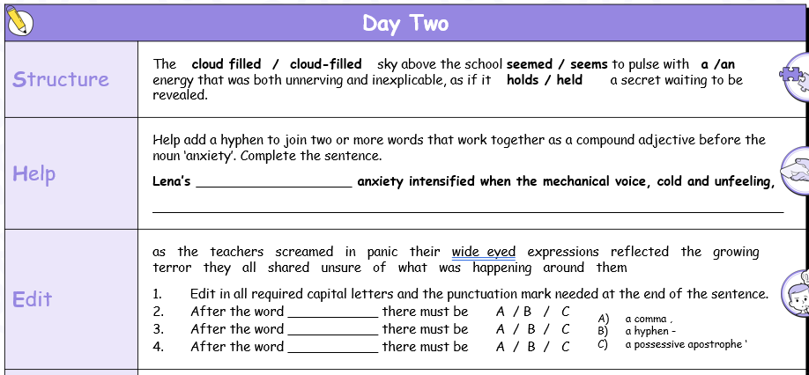

Slide 20
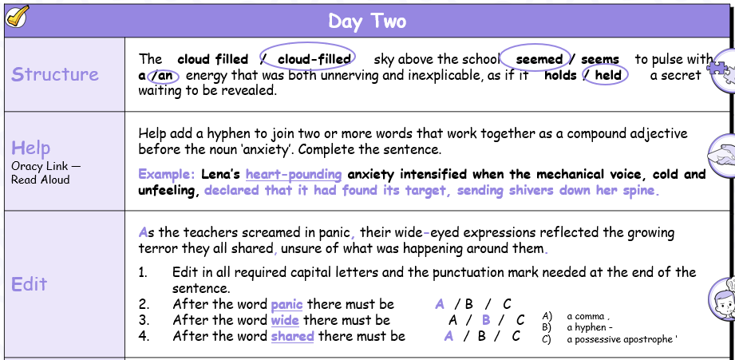

Slide 21
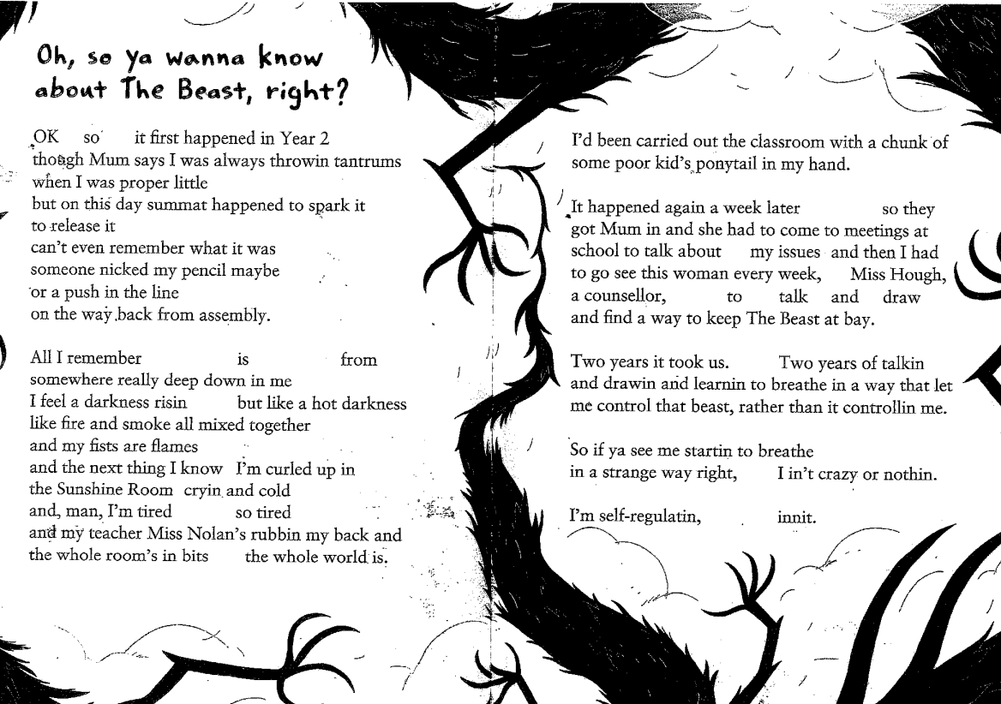

Slide 22
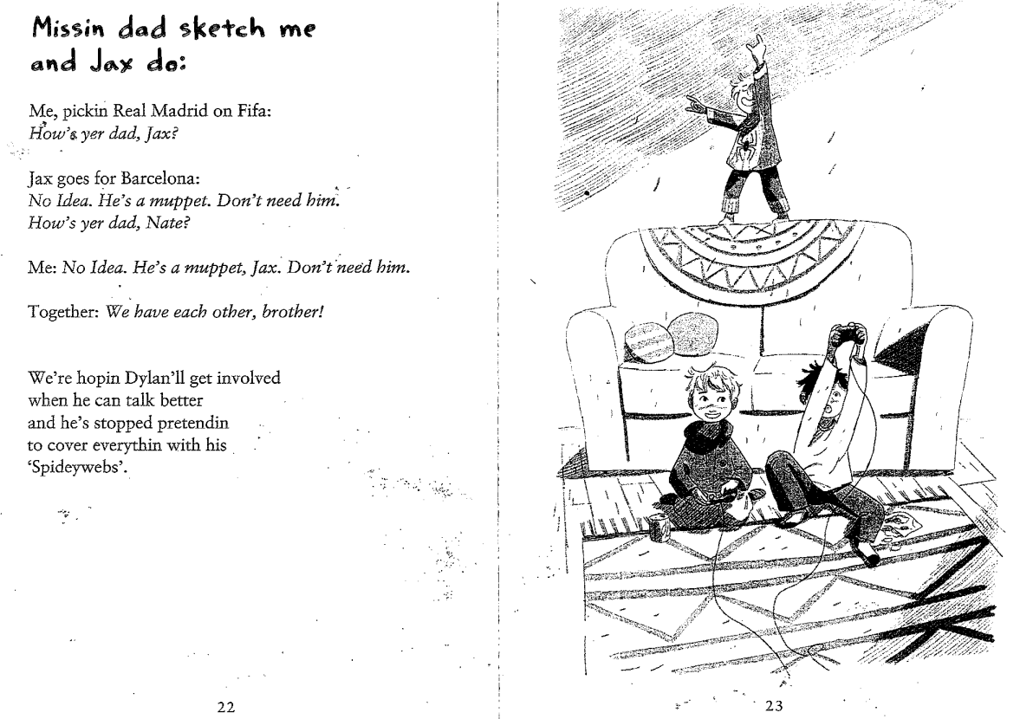

Slide 23
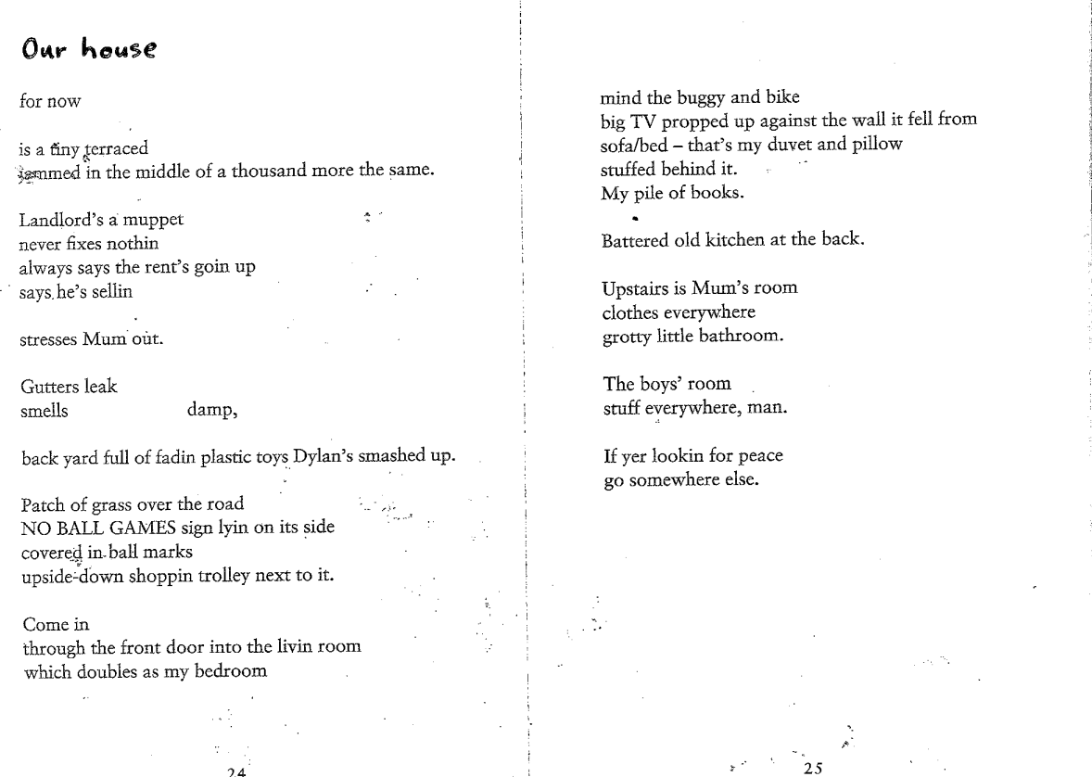

Slide 24
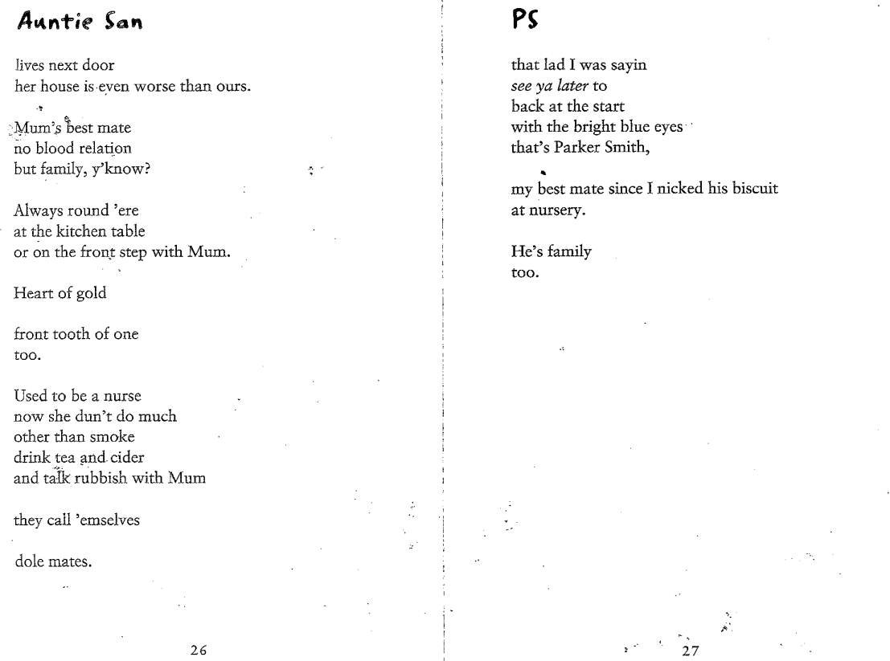

Slide 25
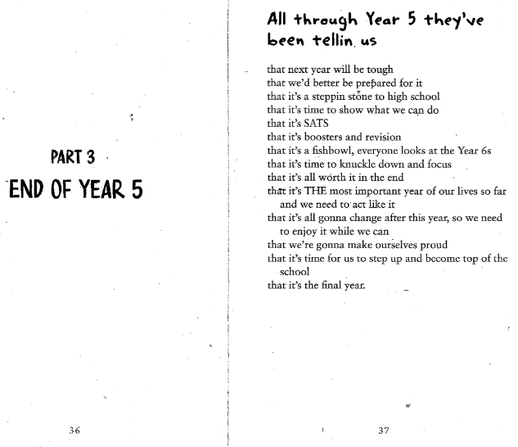
Insert rest of part 3
Notes:
Before Lesson 6, read the remainder of Part 3 together, considering in particular the impact of the poem After registers (the use of columns within it) and the impact of What he dunt say. Use VIPERS questions to engage children and extend their thinking.
In Lesson 6, children will begin to try to find a connection with an author in the way that Nate connects with David Almond. This will be further explored in Week 4 of the unit where they will plan and write a series of poems about this author and their work and the child’s connection to it. For some children, this may be quite a challenging task and they may require quite a lot of support to find an author who inspires them and / or to sustain interest in reading works by an author / and or to move away from an author who does not offer them something inspiring.

Slide 26
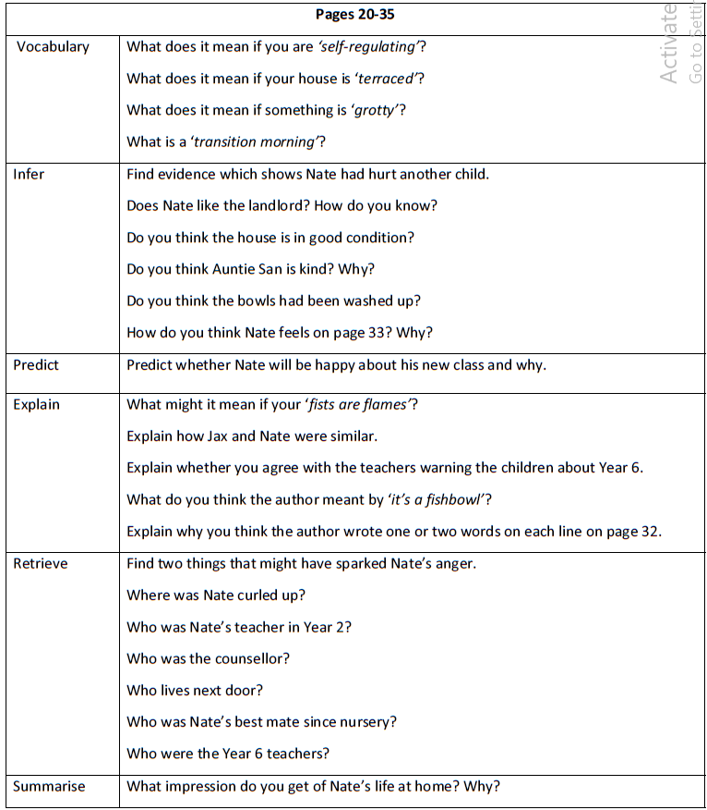

Slide 27
Scaffolds
Adult support
Paired working
Challenge
As task, and then …
How does Matt Goodfellow use language and structure in pages 20–35 to show Nate’s growing sense of responsibility and pressure?
In your answer, explain:
- how Nate’s thoughts and feelings are presented
- how specific language choices create tension or emotion
- how the structure of the verse contributes to the reader’s understanding
Task
Complete VIPERS activity, choosing one from each section and then returning to the start.

Slide 28
Plenary
Exit Question
How do Nate’s feelings change in this section of the text?

Slide 29
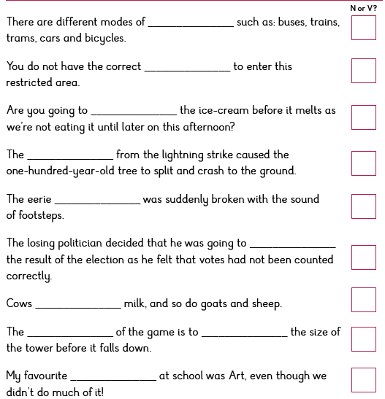


Wednesday 24th June 2026
Spellings – verb or noun?
CHALLENGE – Write your own sentences using your spelling words.
Notes:
Have this printed for ch to put in their handwriting books – HA wont need a sheet

Slide 30
Wednesday 24th June 2026
Reading VIPERS
Our goal for today:
- Use a range of reading skills to develop a deep understanding of the next section of the text.
Notes:
Arthur Spiderwick's Field Guide | PDF

Slide 31
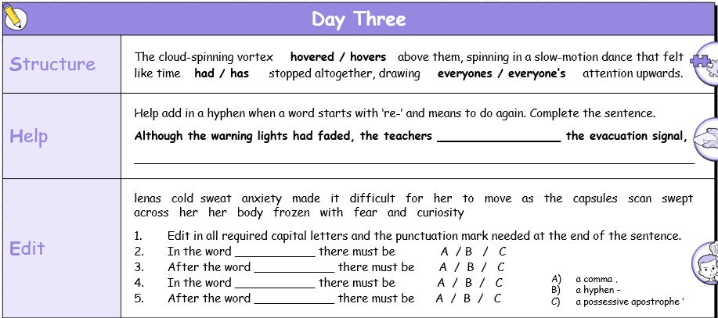

Slide 32
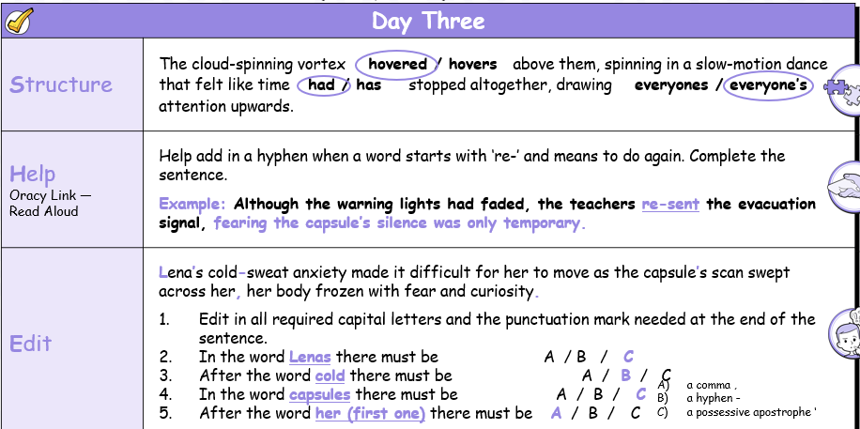

Slide 33
Insert rest of part 3
Notes:
Before Lesson 6, read the remainder of Part 3 together, considering in particular the impact of the poem After registers (the use of columns within it) and the impact of What he dunt say. Use VIPERS questions to engage children and extend their thinking.
In Lesson 6, children will begin to try to find a connection with an author in the way that Nate connects with David Almond. This will be further explored in Week 4 of the unit where they will plan and write a series of poems about this author and their work and the child’s connection to it. For some children, this may be quite a challenging task and they may require quite a lot of support to find an author who inspires them and / or to sustain interest in reading works by an author / and or to move away from an author who does not offer them something inspiring.

Slide 34
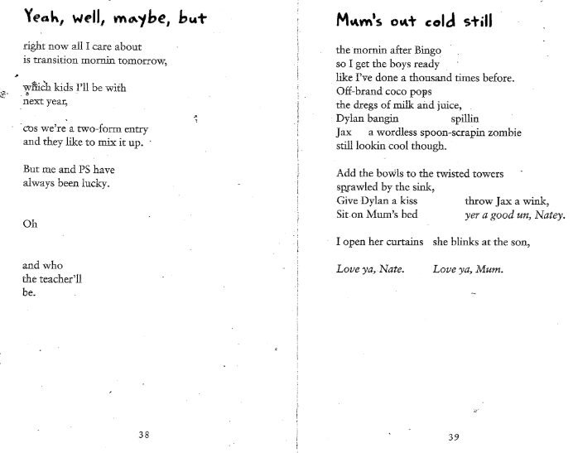

Slide 35
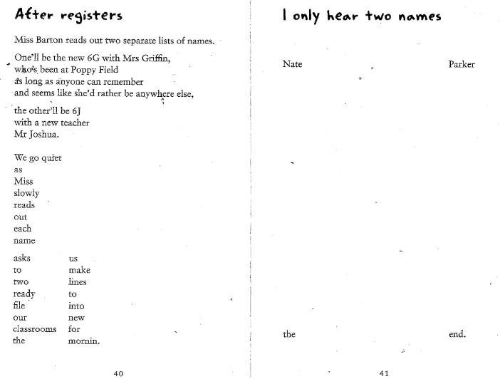

Slide 36
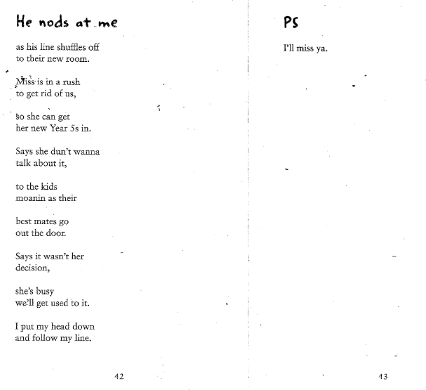

Slide 37
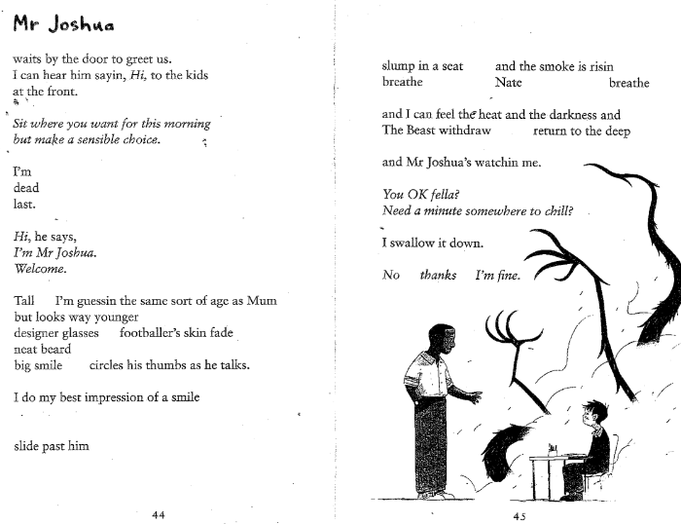

Slide 38
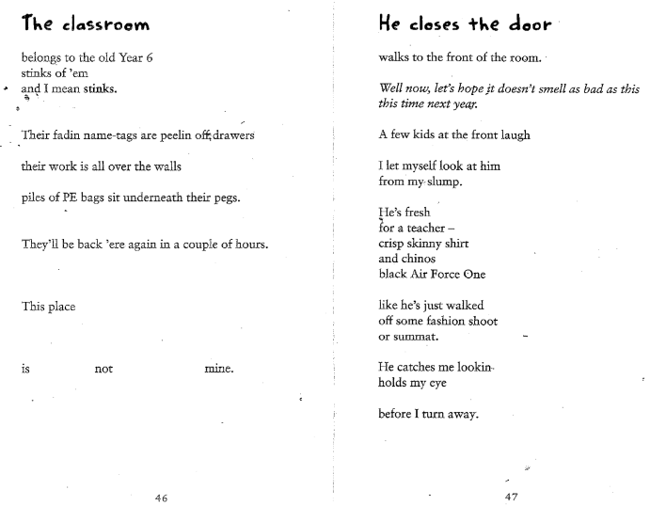

Slide 39
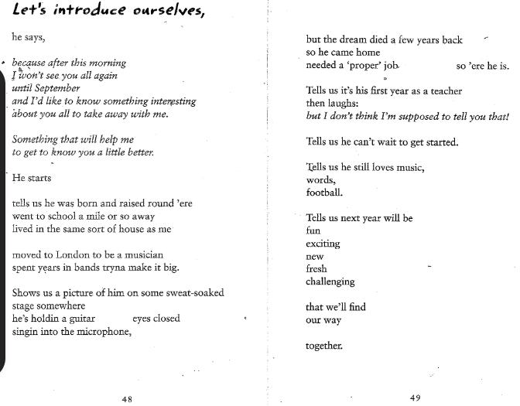

Slide 40
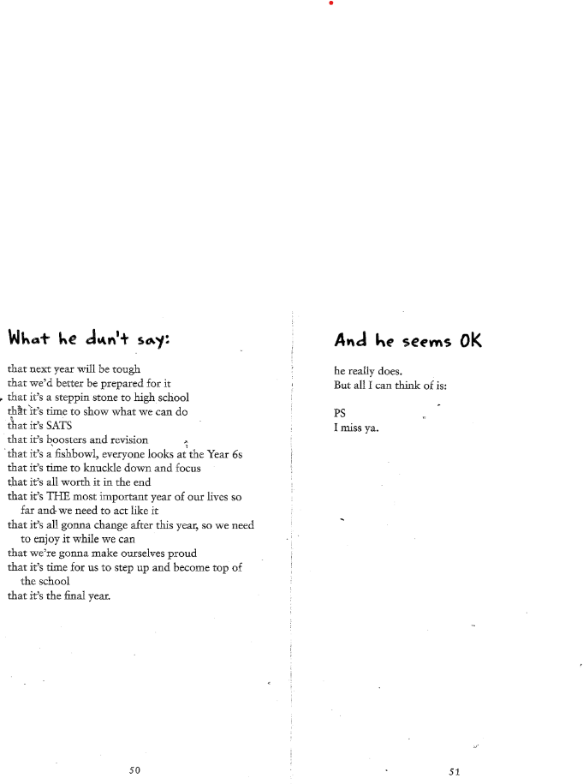

Slide 41
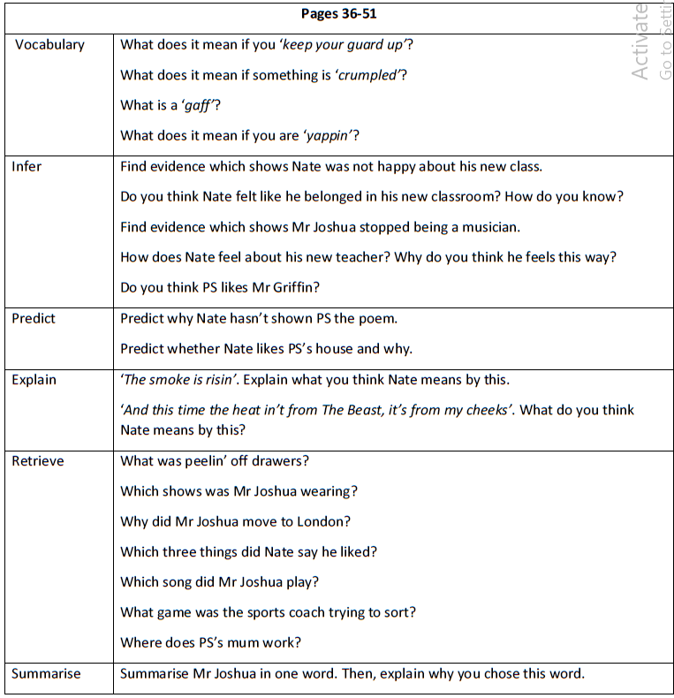

Slide 42
Scaffolds
Adult support
Paired working
Challenge
As task, and then …
In pages 35–51, how does Matt Goodfellow present the relationship between Nate and his brother, and what does this reveal about Nate’s character?
In your answer, explain:
how Nate’s feelings towards his brother are shown
how the poet uses language to suggest responsibility, conflict or care
how the verse structure helps emphasise key moments in their relationship
Task
Complete VIPERS activity, choosing one from each section and then returning to the start.

Slide 43
Plenary
Why do you think Matt Goodfellow chose to focus on Nate’s interactions with his brother in this part of the text?
What does this help the reader to learn and how does it link to the themes of the rest of the text?

Slide 44
Wednesday 24th June 2026
Notes:
Arthur Spiderwick's Field Guide | PDF

Slide 45
Scaffolds
Task
Challenge

Slide 46
Thursday 25th June 2026
Our goal for today:

Slide 49
Notes:
Now hand out copies of Transition (from Let’s Chase the Stars Together) to children working in pairs, with the final two words omitted / blanked out (I’m frightened). Ask children to read the poem with a partner, using the line breaks to guide their performance. Pause children as they rehearse to discuss how this is being done – e.g. children may be alternating reading a line each as though they are two excited children speaking in fragments to their teacher.
Ask them to consider: What is the impact of these stilted, clipped lines? e.g. they effectively convey the nervous excitement felt by the children and the rush of thoughts and recollections etc. as well as the need to ‘show off’ / sound as though they are pleased to be moving on to ‘bigger and better’ things.

Slide 50
Scaffolds
Paired work
Printed versions of the poem.
Task
Rehearse the poem in your pairs.
Consider your use of tone, pace and expression to convey your intended emotion clearly.
Challenge
Are there actions that could accompany the text to emphasis meaning?
Consider the use of physicality in your performance.

Slide 51
Notes:
Draw children’s attention to the fact that two words have been omitted from the end of the poem. What could these be? Discuss.
Now reveal the words and ask children to discuss with their partner (combined with other partners within small groups if preferred) what impact these two words have upon the whole poem. Now ask them to consider how this poem impacts them personally? Explain that every child reading this poem will likely have an emotional reaction to it. Although there will be similarities between children’s thoughts and feelings about it, everyone’s reaction will be slightly different and clarify that you would like them to consider what about it connects with them personally. Ask children to respond to this in their jotter.

Slide 52
Scaffolds
Paired work
Printed versions of the poem.
Task
Continue to rehearse a performance of the poem with your partner.
Now you know what the final two words are and have considered the impact of these, adapt your delivery of the poem accordingly.
Challenge

Slide 53
Plenary
How has the poem you performed today related to the story we are studying this half term? Does the front cover reflect the tone of the poem in today’s lesson.

Slide 54
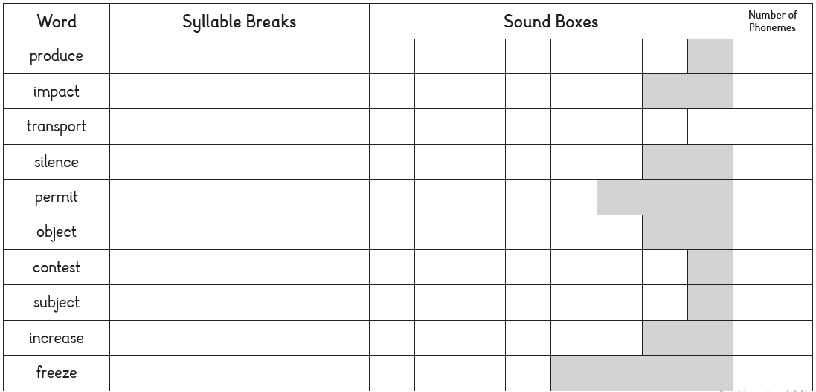
Thursday 25th June 2026
Syllable breaks

Slide 55
Friday 26th June 2026
Spelling Test
1.
2.
3.
4.
5.
6.
7.
8.
9.
10.
Notes:
produce
impact
transport
silence
permit
object
contest
subject
increase
freeze

Slide 56
Answers
produce
impact
transport
silence
permit
object
contest
subject
increase
freeze

Slide 57
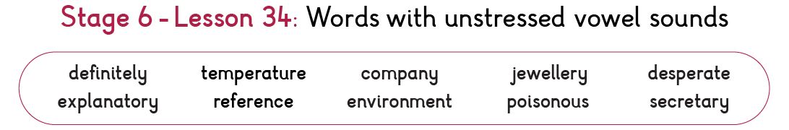
Next week’s spellings

Slide 58
Friday 26th June 2026
Write about myself in verse.
Our goal for today:
Write a verse based on yourself
Consider use of imagery, pace and rhythm.

Slide 59
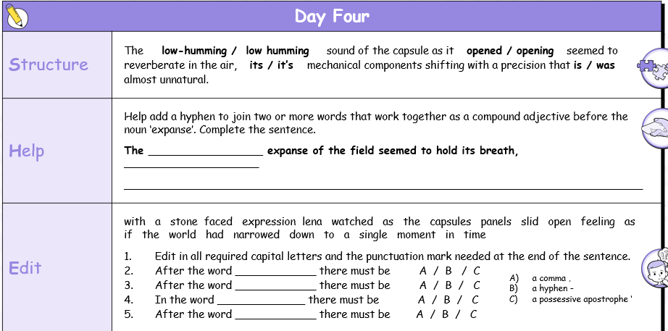

Slide 60
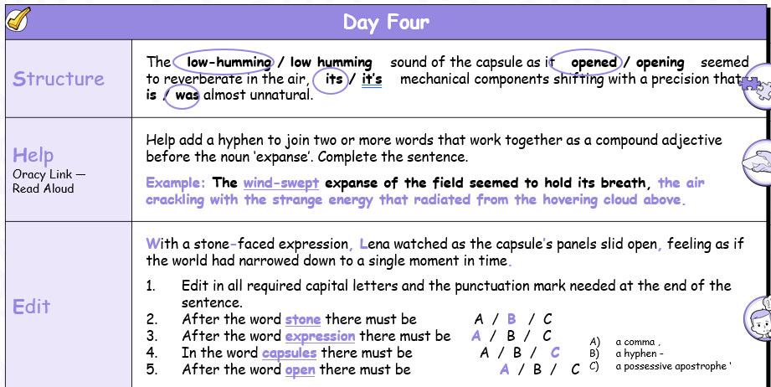

Slide 61
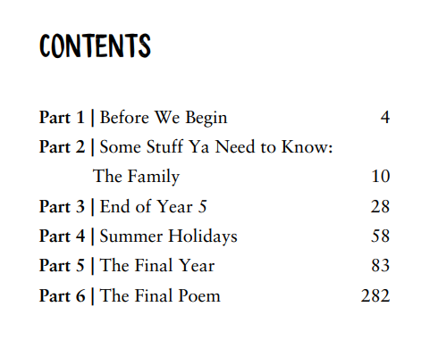
Notes:
Now hand out copies of the novel and look together at the contents. Ask the children to identify where they are in this, in their own lives. What is ahead for them next? (e.g. are they at the end of Year 5 / in their final year? etc.)

Slide 62
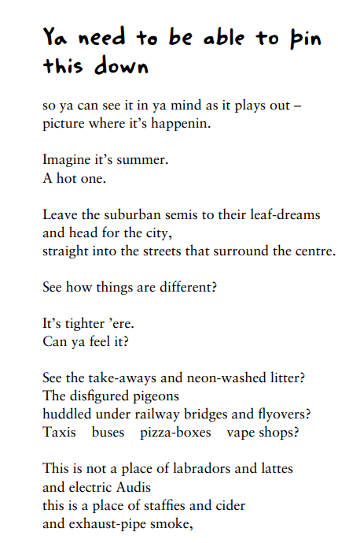
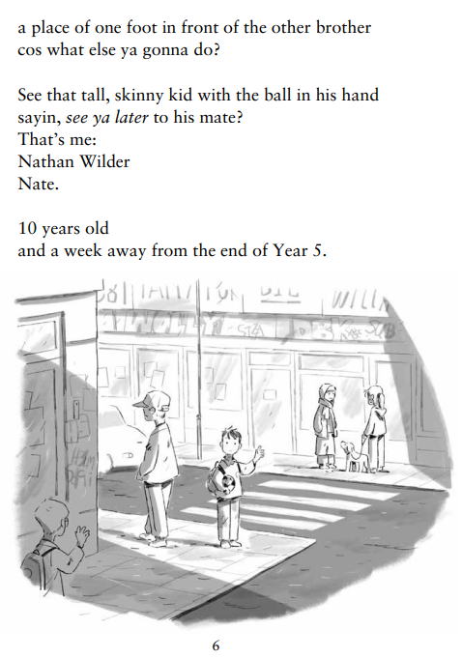
Notes:
Now read ‘Ya need to be able to pin this down’ to the class. Then ask children to select a partner to rehearse reading this aloud with. Allow pairs 5 or 10 minutes to do so.
Discuss the use of ‘enjambment’ (line breaks used mid-clause) for pace and emphasis.
How does this opening chapter grab the reader? Discuss. If it were written in a more traditional narrative style, what would be different and what would be the impact of these differences?*
Discuss the way the reader feels as if they are being spoken directly to by Nate in Matt Goodfellow’s verse and that to hear Nate’s story in his words and expression, connects us immediately with him.
Ask children what is the impact of the description of what can be seen on his street (e.g. litter, disfigured pigeons and vape shops). This directness and openness about where he lives gives us an idea that he is honest and real and unguarded.

Slide 63
Nate
Notes:
Write these words (litter, disfigured pigeons and vape shops and others suggested by children) around ‘Nate’ on a flipchart page.
What else do we learn from this? Is this a familiar type of scene to the children? Discuss children’s experiences of similar settings. Now ask children to read ‘aloud in their heads’ (imagining they are performing the verse aloud) the rest of part 1. They should do so at least twice.
Next, explain that the children’s task today is to have a go at writing about themselves in Matt Goodfellow’s style. Children must imagine a short moment in their life which happens regularly which includes the people closest to them.

Slide 64
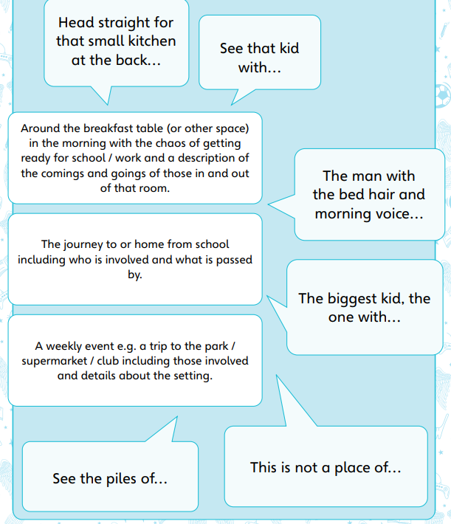
Notes:
Display Resource 2a which has three suggestions (children may have other ideas which they can run past you). Remind children that this should be something mundane which allows a snapshot of them living their normal life to be taken. Point out the phrases surrounding the options, suggesting that children use and adapt these or similar ideas

Slide 65
I’m not just the loud one at the back,
I’m questions spinning, keeping track.
People see jokes, the easy grin—
they don’t always see what’s underneath my skin.
Some days I’m fearless, ready to try,
some days I doubt, but I still aim high.
Not there yet—but I’m on my way,
learning more with every day.
Notes:
Share the example with children and explain that they will need to write a verse about their own selves for the task.

Slide 66
Scaffolds
Word bank
Example
Sentence starters
Challenge
Write an additional verse that shows contrast, depth, and individuality by:
✅ Including contrasting sides of yourself→ e.g. “People see…, but they don’t see…”
✅ Using at least one extended metaphor or image
✅ Experimenting with rhythm and repetition for effect
✅ Showing change or growth over time→ e.g. who you were → who you are becoming
✅ Ending with a strong, memorable final line→ something that stays with the listener
Task
- describe a mundane
scene from your life in Matt
Goodfellow’s style.
- use phrases (adapted) from
Resource 2a to support this.

Slide 67
Plenary
Performance time!
Who would like to share their verse?

