Slide 1

Phonics workshop
Tuesday 12th October 2021

Slide 2

Notes:
Why phonics?
The ability to read and write is vital for all children, paving the way for an enjoyable and successful school experience.
Phonics helps to develop good reading and spelling skills.

Slide 3
National Phonics screening check
The national phonics screening check is a statutory assessment introduced in 2011 to all Year 1 pupils.
This was paused due to the pandemic (2019 & 2020).
All year 1 pupils will take the phonics screening check the week beginning 6th June 2022.
Year 2 will be taking the screening check in Autumn two (early December). This is due to the pandemic and the screening being paused in 2019/2020.
It consists of a list of 40 words; 20 real words and 20 nonsense words.
It will assess phonics skills and knowledge learnt through reception and year 1.
The pass mark is usually around 32/40.
They will be asked to ‘sound out’ a word and blend the sounds together to read the word.
Notes:
They will be asked to ‘stetch and ping’ the word.

Slide 4
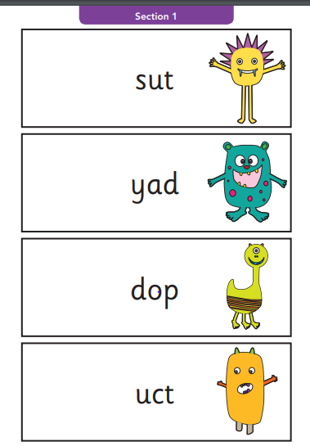
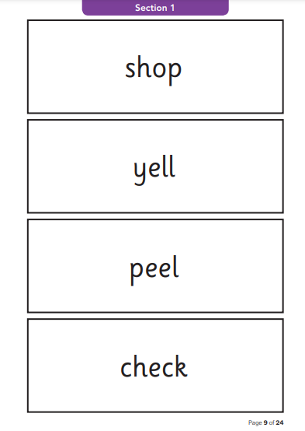

Slide 5
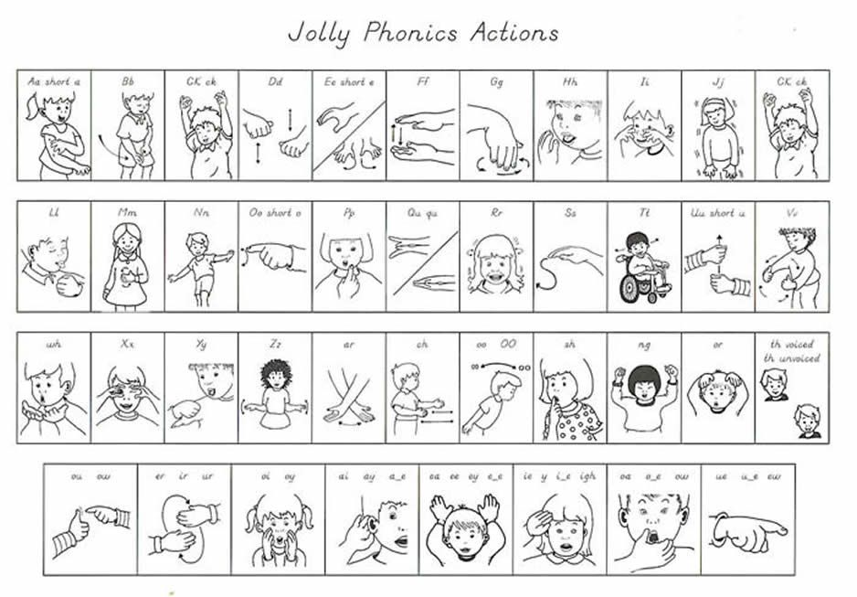
At HCFS we use Jolly phonics actions.
The symbol sheet for the actions can be found on the website.
https://www.hcfs.org.uk/phonics-20/

Slide 6
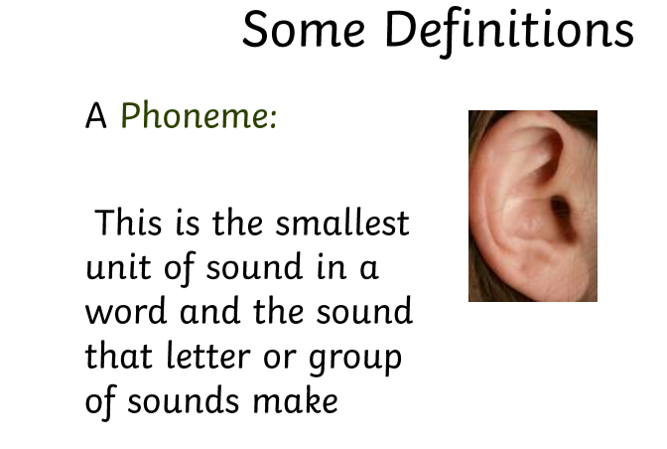
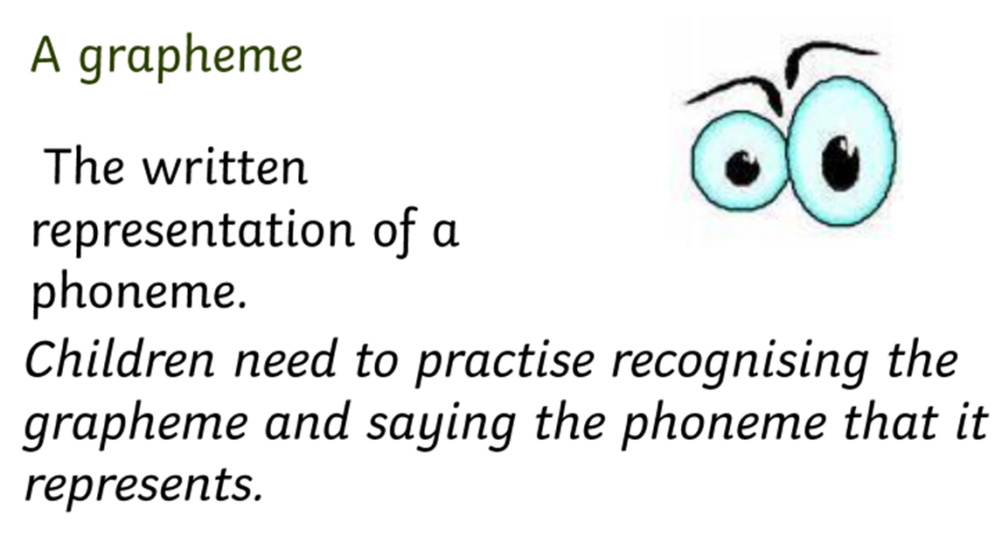

Slide 7
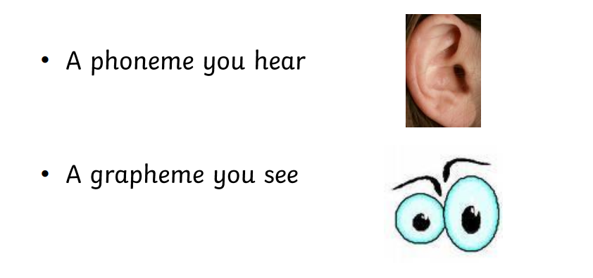

Slide 8
A grapheme could be 1 letter, 2 letters or more!
t ai igh
Trigraph
Digraph
A phoneme can be represented/spelled in more than one way:
cat, kennel, rocket

Slide 9
Chair long light
Can you spot the graphemes in these words?
Are they digraphs or trigraphs?
We use sound buttons in phonics to support spotting the sounds.

Slide 10
Segmenting= stretching
Blending= pinging
Segmenting involves breaking down a word into each of its sounds to help children learn how to write it out.
Blending is the process of combining the sounds together to create a word.

Slide 11
might

Slide 12
farm

Slide 13
hurt

Slide 14
Phonics lessons.
Revisit/ review- Using flashcards and jolly phonics actions.
The actions support children in remembering their sounds.
Teach- teach phoneme with action. The letters that make the sound.
Blending- stretch and pinging a word.
Segmenting- having a go at writing a word using sound buttons.
Apply- writing a sentence.

Slide 15
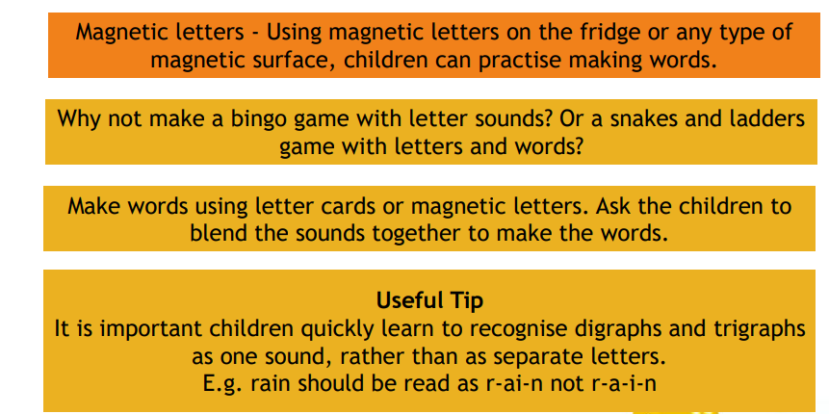
How can I help?

Slide 16
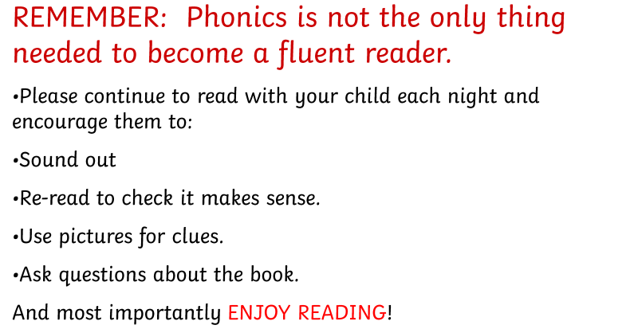

Slide 17
Useful links…
www.phonicsplay.co.uk
www.oxfordowl.co.uk
Apps
Hairy Phonics
Read with phonics
Teach your monster to read

Slide 18
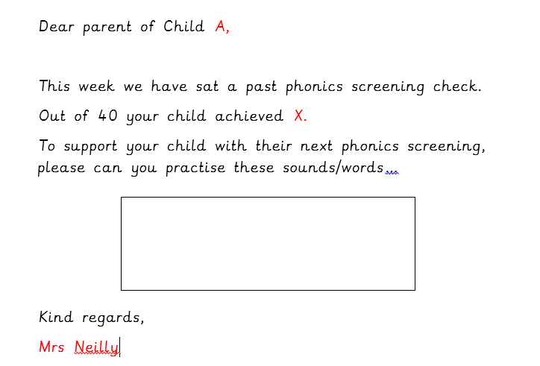
We will be doing past phonics screening checks every four weeks.

Slide 19
Activities:
Miss Miles – phonics bingo
Miss Undy - Sound buttons
Miss Wilson – Alien words vs real words
Mrs Steele – teaching phonics through picture taking
Mrs Neilly – creating words with different sounds

